Slide 1
Natural Language Processing
Week 5

Slide 2
Good evening, everyone. Welcome to the live session.
Today, we will be practicing problems from the current week’s content.
We will wait 5 minutes for everyone to join in and start at 7:05 pm.

Slide 3
Question 1: Which of the following are true?
A) Given a CFG and its corresponding CNF, they both produce the same
language.
B) For a given grammar, there can be more than one CNF.
C) It requires ‘2n+1’ productions or steps in CNF to generate a string w of length ‘n’.
D) None of the above

Slide 4
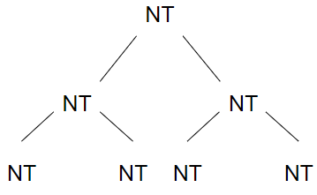

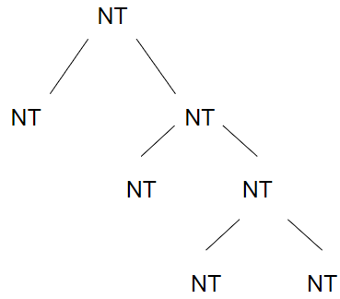
Solution
Answer: A, B
Solution: In CNF,
Let n be the length of a string. In CNF, each NT can give exactly two NTs.
We start with the (non-terminal) symbol S. Using (n−1) rules of form NT→ NT NT (where NT represents a non−terminal), we can construct a string containing ‘n’ non-terminal symbols. Then on each NT symbol of said string of length ‘n’ we apply a rule of form NT→T. i.e. we apply n rules. In total we will have applied (n−1) + n = 2n−1 rules.

Slide 5
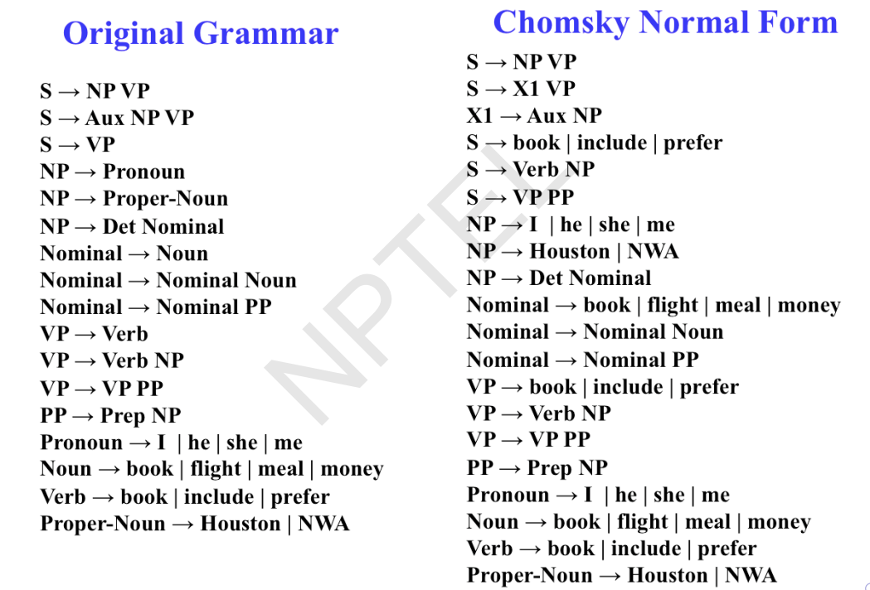

Slide 6
Question 2: Consider the CFG given below:
S → aSb|D
D → Dc|ε
How many non-terminals should be added to convert the CFG into CNF?
A) 3
B) 2
C) 4
D) 5

Slide 7
Solution
Answer: D
Solution: Given: S → aSb|D, D → Dc|ε
Since the start symbol S occurs on the right side of a production rule, we create a new start symbol S’ and a new production rule S’ → S.
S’ → S, S → aSb|D, D → Dc|ε
Remove the null productions: D → ε, S → ε
After removing D → ε: S’ → S, S → aSb|D|ε, D → Dc|c
After removing S → ε: S’ → S, S → aSb|D|ab, D → Dc|c
Remove the unit productions: S → D, S’ → S
After removing S → D: S’ → S, S → aSb|ab|Dc|c, D → Dc|c
After removing S’ → S: S’ → aSb|ab|Dc|c, S → aSb|ab|Dc|c, D → Dc|c

Slide 8
Solution
S’ → aSb|ab|Dc|c, S → aSb|ab|Dc|c, D → Dc|c
4. Since the right-side of the production rules contain both terminal and non-terminal, we add the following rules: A → a, B → b, C → c
S’ → ASB|AB|DC|c, S → ASB|AB|DC|c, D → DC|c, A → a, B → b, C → c
5. Handling the cases where there are more than two non-terminals on the right-hand side by adding the rule E → SB:
S′ → AE|AB|DC|c, S → AE|AB|DC|c, E → SB, D → DC|c, A → a, B → b, C → c

Slide 9
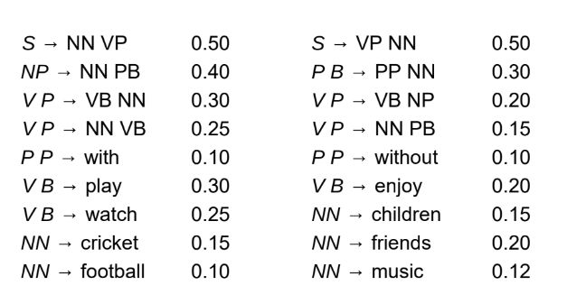

Slide 10
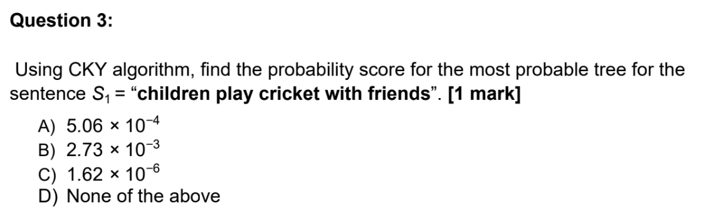

Slide 11
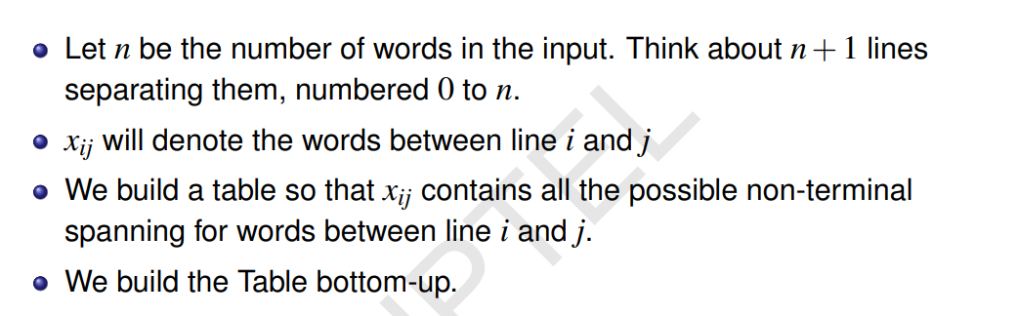
Solution

Slide 12
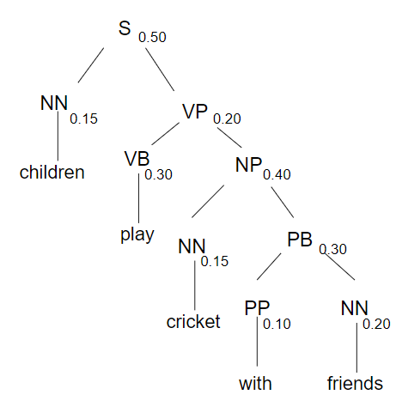
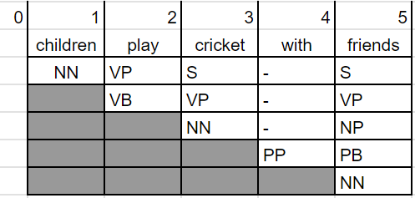
Solution
Answer: C
Solution:

Slide 13
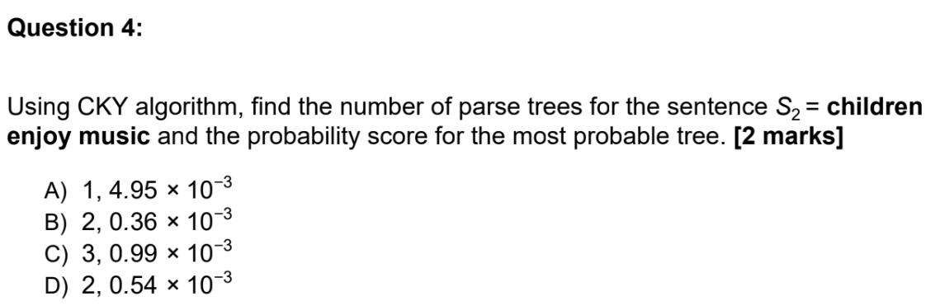

Slide 14
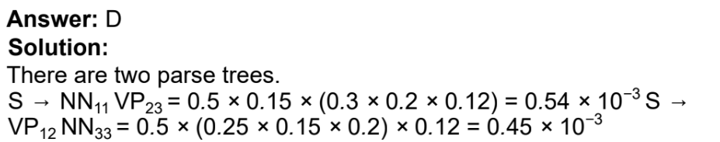
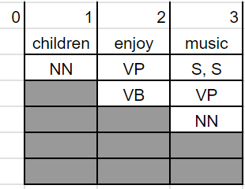
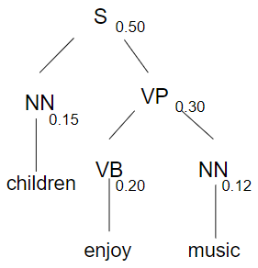
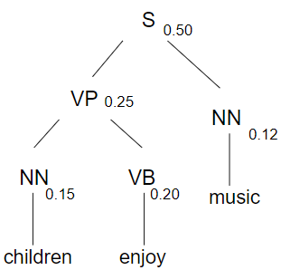
Solution

Slide 15
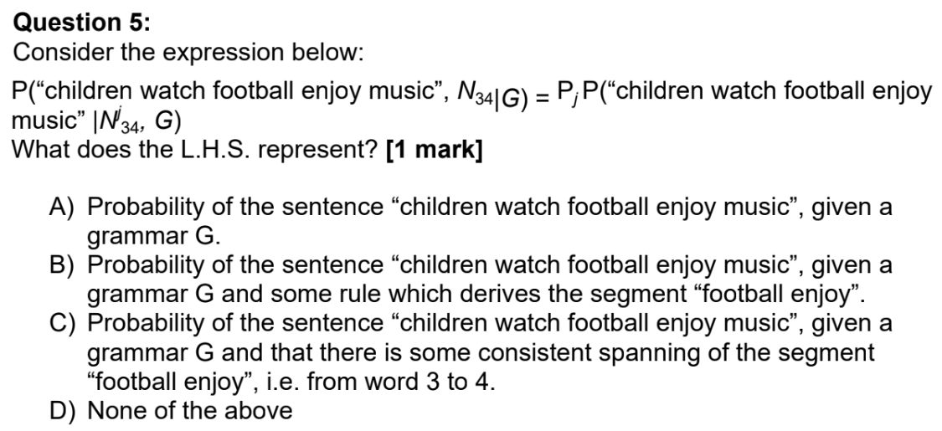

Slide 16
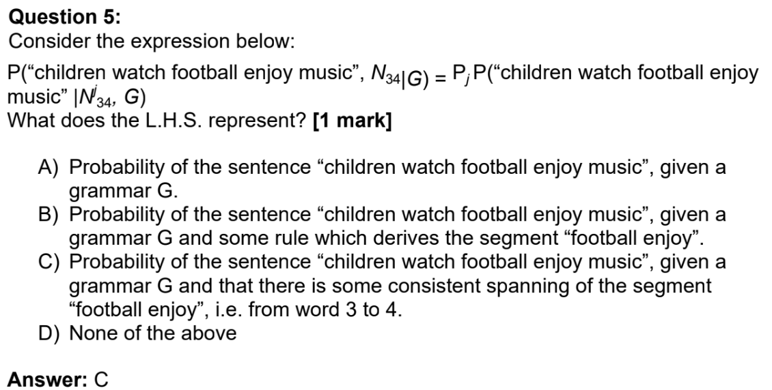
Solution

Slide 17
Question 6: Which of the following are true with respect to a Top-Down and Bottom-Up Parser?
A) A Top-Down Parser never explores options that will not lead to a full parse.
B) A Bottom-Up Parser never explores options that will not lead to a full parse.
C) A Top-Down Parser never explores options that do not connect to the actual
sentence.
D) A Bottom-Up Parser never explores options that do not connect to the actual
sentence.

Slide 18
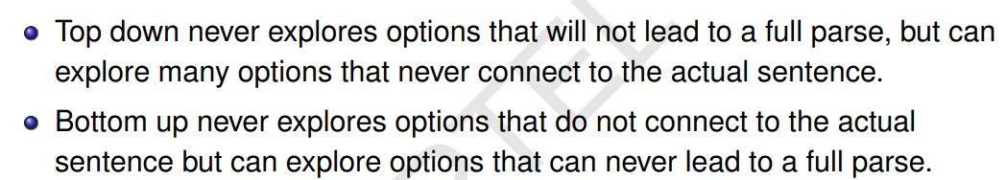
Solution
Answer: A, D

Slide 19
Question 7: Consider the CFG given below:
S -> ASA | aB
A -> B | S
B -> b | ε
How many non-terminals need to be added to convert the above grammar into CNF?
A) 1
B) 4
C) 2
D) 3

Slide 20
Solution
Answer: D
Solution: Given: S → ASA|aB, A → B | S, B → b | ε
Since the start symbol S occurs on the right side of a production rule, we create a new start symbol S’ and add a new production rule S’ → S.
S’ → S, S → ASA | aB, A → B | S, B → b | ε
Remove the null productions: B → ε, A → ε
After removing B → ε: S’ → S, S → ASA|aB|a, A → B|S|ε, B → b
After removing A → ε: S’ → S, S → ASA|aB|a|AS|SA|S, A → B|S, B → b
Remove the unit productions: S → S, S’ → S, A → B, A → S
S’ → ASA|aB|a|AS|SA, S → ASA|aB|a|AS|SA, A → b|ASA|aB|a|AS|SA, B→ b

Slide 21
Solution
S’ → ASA|aB|a|AS|SA, S → ASA|aB|a|AS|SA, A → b|ASA|aB|a|AS|SA, B→ b
4. Handling production rules with more than two non-terminals on RHS:
S’ → AX|aB|a|AS|SA, S → AX|aB|a|AS|SA, A → b|AX|aB|a|AS|SA, B→ b,X → SA
5. Since the right-side of the production rules contain both terminal and non-terminal, we add the following rules: Y → a
S’ → AX|YB|a|AS|SA, S → AX|YB|a|AS|SA, A → b|AX|YB|a|AS|SA, B→ b, X → SA, Y → a

